Slide 1
Inbound Order Process
WMS Guide

Slide 2
Table of Contents
Regular Receiving........................................................................................................3
Prerequisite……............................................................................................................4
Receive Tracker............................................................................................................6
Receipt Schedules….....................................................................................................9
Inbound Order Planning & Receiving........................................................................13
Receipt Closeout........................................................................................................23
Quality Check (if applicable)......................................................................................27
Release for Putaway...................................................................................................34
Basic Receiving..........................................................................................................38

Slide 3
Regular Receiving

Slide 4
Prerequisite

Slide 5
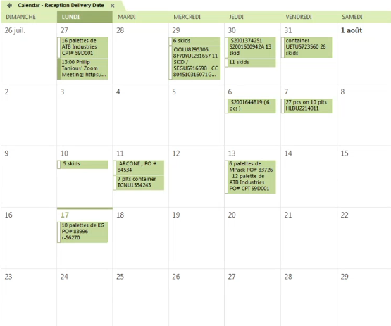
Prerequisite
Refer to the "Reception Delivery Date" calendar to know what is expected to be received and when at the warehouse.
The calendar also allows you to know the container number that will be used for the receiving. Take note of the container number.

Slide 6
Step 1 – Receiver Tracker

Slide 7
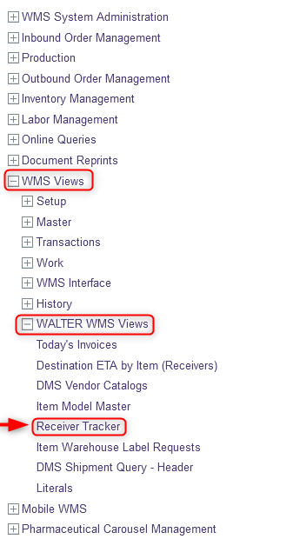
Step 1 - Receive Tracker
With a desktop computer, select the WMS Views resource
Under WMS Views, click on WALTER WMS Views
Under WALTER WMS Views, click on Receiver Tracker

Slide 8
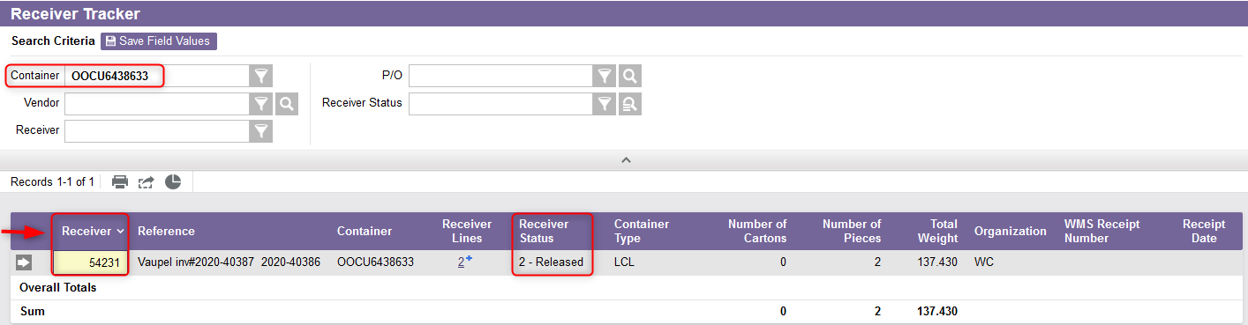
Step 1 - Receive Tracker
From the new window, enter the container number in the search criteria.
This allows you to obtain the receiver number. Take note of the receiver number. Note: The receiver is supposed be released.

Slide 9
Step 2 – Receipt Schedules

Slide 10
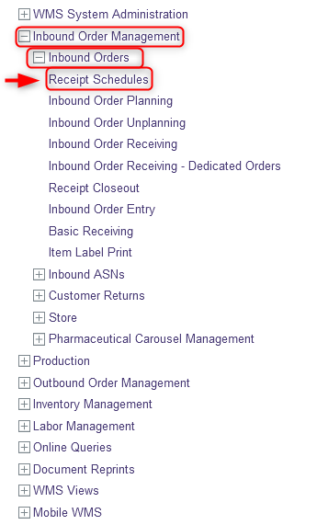
Step 2 – Receipt Schedules
From a desktop computer, select the Inbound Order Management resource
Under Inbound Orders, click on Receipt Schedules

Slide 11
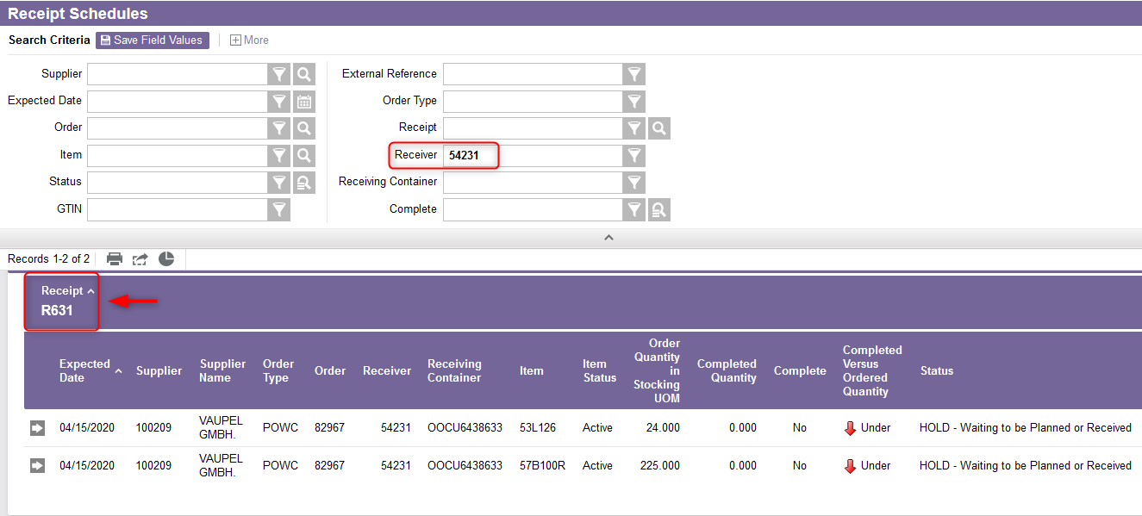
Step 2 - Receipt Schedules
From the new window, enter the receiver number in the search criteria.
Take note of the appropriate Receipt number.

Slide 12
Step 2 - Receipt Schedules
Additional note:
At this stage, if the purchasing department has released a receiver but finally the receiver needs to be canceled for any reason, it is no longer possible to cancel the receiver directly in the WMS. Therefore, this is the responsibility of purchasing to cancel the receiver in the DMS. In such a case, inform purchasing as soon as possible.

Slide 13
Step 3 – Inbound Order Planning & Receiving

Slide 14
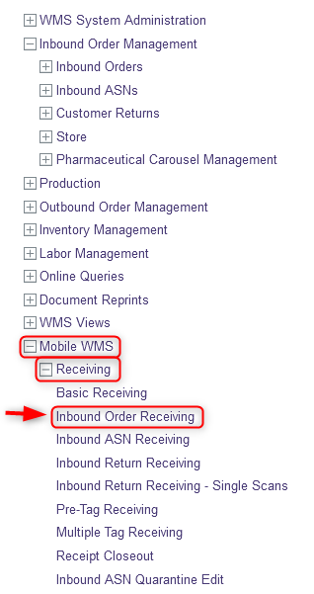
Step 3 – Inbound Order Planning & Receiving
With your mobile device, select the Receiving resource
Under Receiving, Click on Inbound Order Receiving

Slide 15
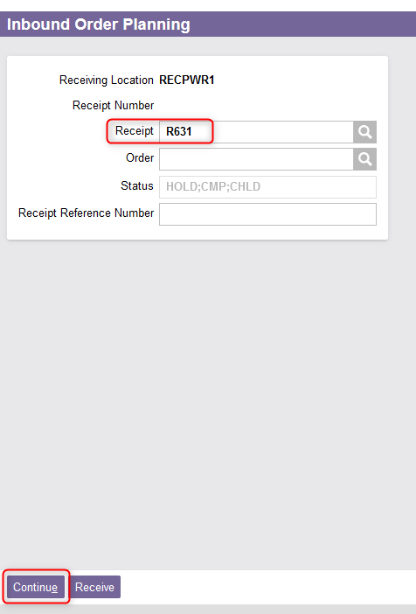
Step 3 – Inbound Order Planning & Receiving
From the Inbound Order Planning window, enter the receipt number.
Then click on Continue.

Slide 16
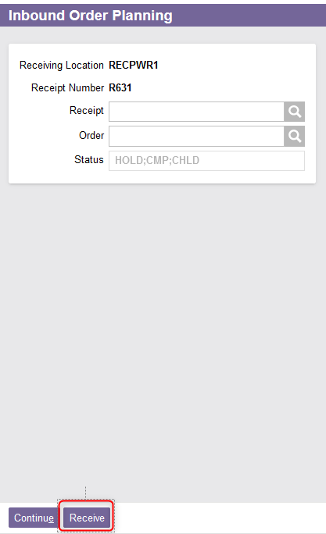
Step 3 – Inbound Order Planning & Receiving
A second page of the Inbound Order Planning will appear.
  Click on Receive.

Slide 17
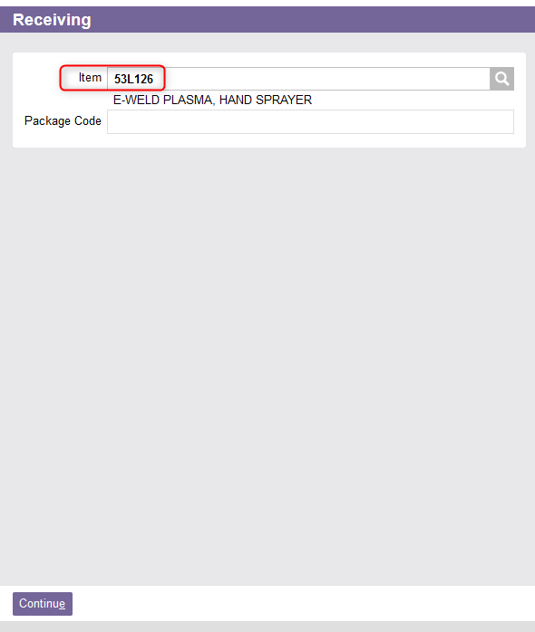
Step 3 – Inbound Order Planning & Receiving
A new Receiving window will appear. From this new window, enter the item to be received.
Click on Continue

Slide 18
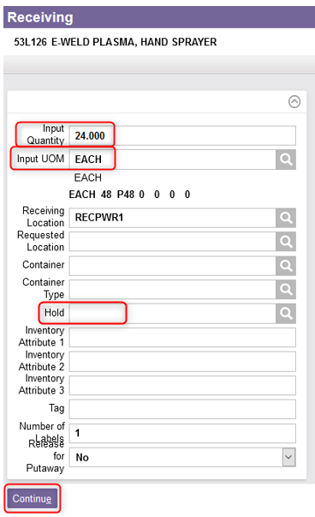
Step 3 – Inbound Order Planning & Receiving
A second page of the Receiving window will appear. Confirm the quantity and the unit of measure of the item being received.
If required, enter a hold code (e.g. for a damaged item, discontinued item, new item, etc.). Use the lookup button to find the right code if necessary.
Click on Continue.

Slide 19
Step 3 – Inbound Order Planning & Receiving
Repeat steps 15 to 19 for all items to be received for this receipt. And finally click on Continue.
A confirmation message will appear: “Receiving has been completed for receipt R631.”

Slide 20
Step 3 – Inbound Order Planning & Receiving
Additional note - Receive more than ordered quantity:
The over receipt tolerance is 5%. Therefore, it is not necessarily possible to over-receive an item more than the quantity ordered beyond this tolerance level. Example: For a purchased quantity of 24, it is only possible to over-receive a maximum quantity of 25.2. In such a case of discrepancy, Purchasing will be notified by email.
  If the excess quantity has been approved, Purchasing must create another receiver for the quantity in excess.
  If the excess quantity has not been approved, then the item must be returned to the supplier and transport must be arranged accordingly.

Slide 21
Step 3 – Inbound Order Planning & Receiving
Additional note - Receive less than ordered quantity:
However, it is possible to receive less than the quantity ordered.
In such a case of discrepancy, Purchasing will be notified by email and the purchase order will be kept open.
Purchasing needs to create another receiver for further receiving of the remaining quantities.

Slide 22
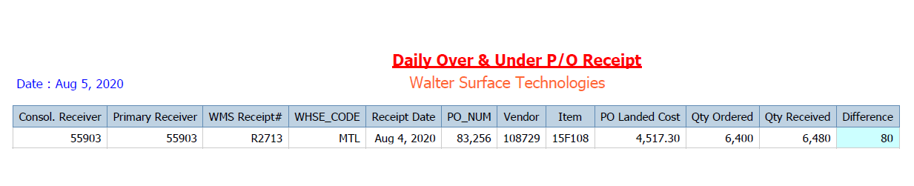
Step 3 – Inbound Order Planning & Receiving
Additional note (continued) :
A daily report is generated by Tecsys to account for such situations and inform Purchasing of these discrepancies:

Slide 23
Step 4 – Receipt Closeout

Slide 24
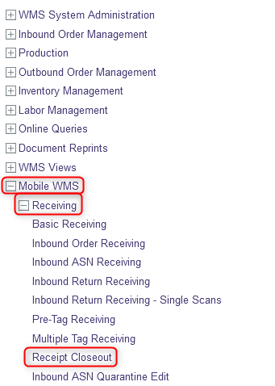
Step 4 – Receipt Closeout
Note: The Receipt Closeout action is performed once per day using a desktop computer.
Select the Receiving resource
Under Receiving, Click on Receipt Closeout

Slide 25
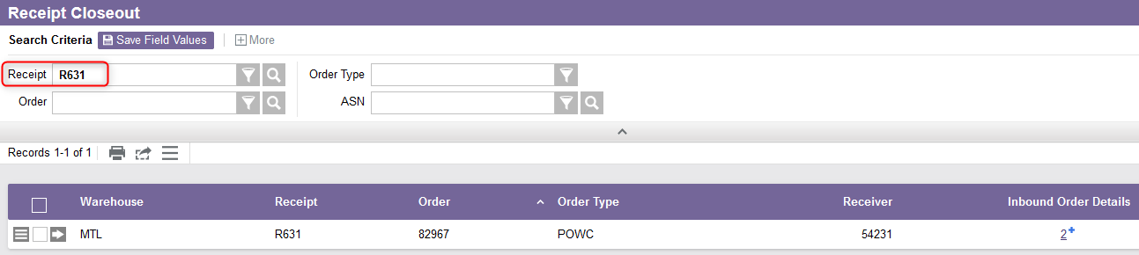
Step 4 – Receipt Closeout
From the Receipt Closeout window, use the search criteria to retrieve the receipt you wish to close.

Slide 26
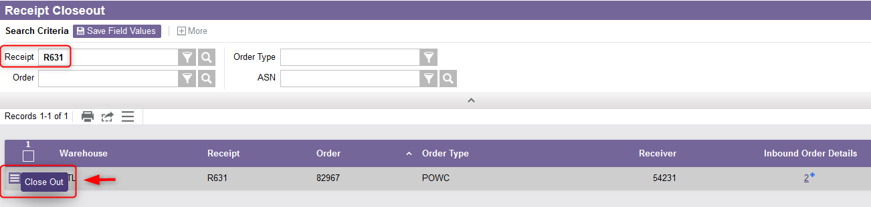
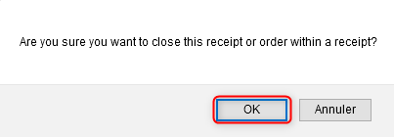
Step 4 – Receipt Closeout
Select the Use Record as Criteria for Action button and click on the Close Out action.
A message will appear asking you to confirm the close out, select OK.
The WMS will generate a message confirming that the request has been submitted for processing.

Slide 27
Step 5 – Quality Check (if applicable)

Slide 28
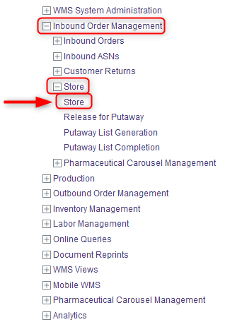
Step 5 – Quality Check (if applicable)
Note: If the product has to be placed in Quality Check for any reason, this must be done immediately so that the product is not available for sale. In such a case, from a desktop computer, you first need to move the item to the RCPWR1 location. To do this:
Select the Inbound Order Management menu.
Under Store, click on Store again.

Slide 29
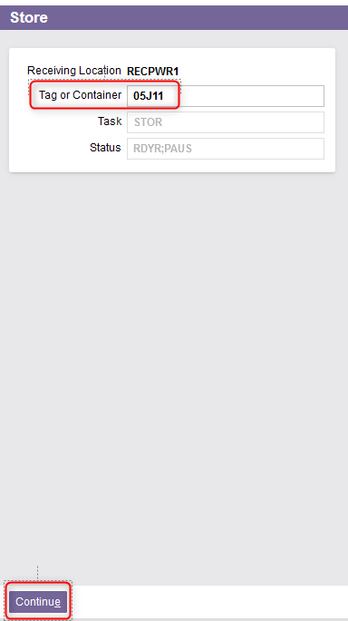
Step 5 – Quality Check (if applicable)
Scan the Tag or Container to be stored.
Click Continue.

Slide 30
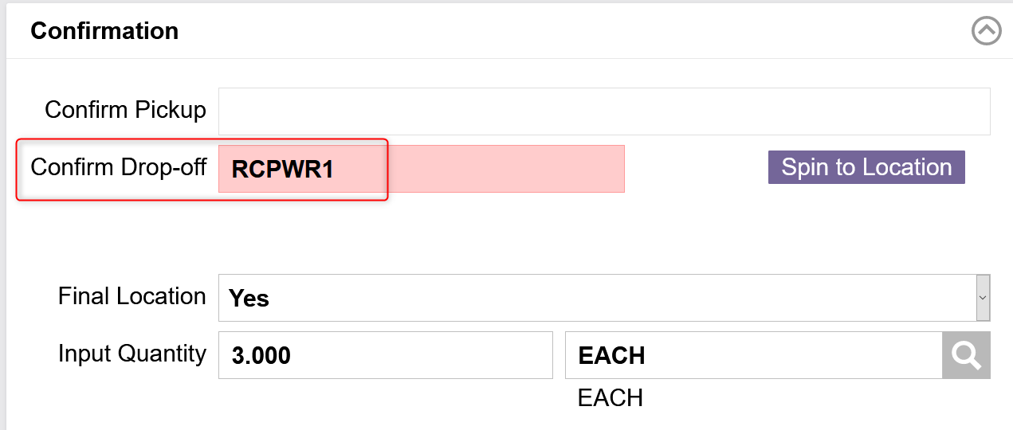
Step 5 – Quality Check (if applicable)
From the new window, confirm the Drop-off point by entering RCPWR1.
Click Continue.
The item has been stored in the RCPWR1 location.

Slide 31
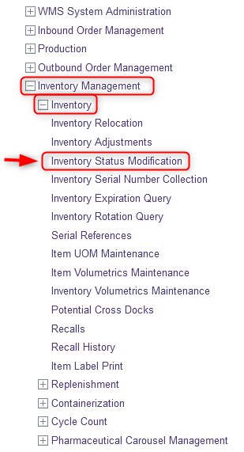
Step 5 – Quality Check (if applicable)
Then, you need to change the status of the item. To do this:
Select the Inventory Management resource
Under Inventory, Click on Inventory Status Modification.

Slide 32
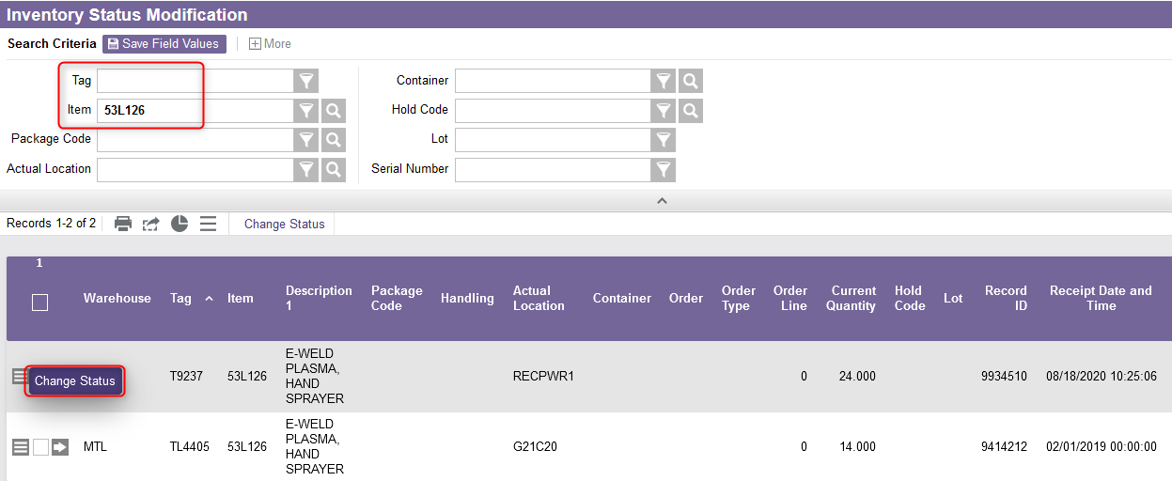
Step 5 – Quality Check (if applicable)
From the new window, use the search criteria by using either the Tag or Item identifier to retrieve the item you wish to place in quality check.
Select the Use Record as Criteria for Action button and click on the Change Status action.

Slide 33
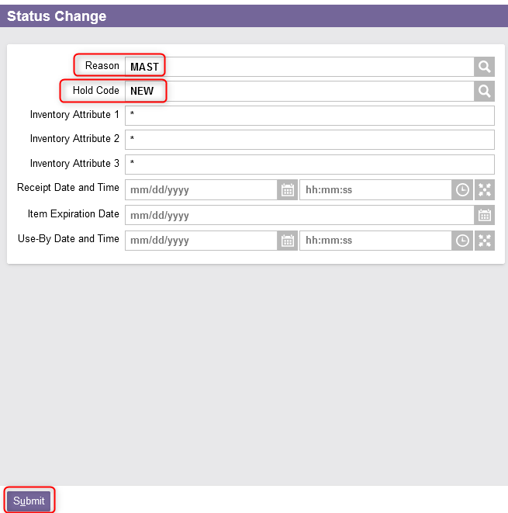
Step 5 – Quality Check (if applicable)
Enter the appropriate Reason and Hold Code. Use the lookup button if needed.
Then Click on Submit.
  A confirmation message will appear, and the hold will be applied to the item.

Slide 34
Step 6 – Release for Putaway

Slide 35
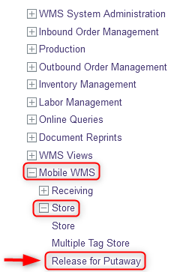
Step 6 – Release for Putaway
With your mobile device, select the Store resource.
Under Store, Click on Release for Putaway.

Slide 36
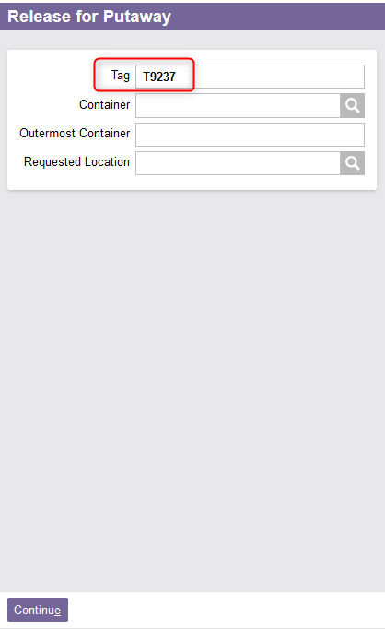
Step 6 – Release for Putaway
In the new window, scan the Tag to be released.
Click on Continue.

Slide 37
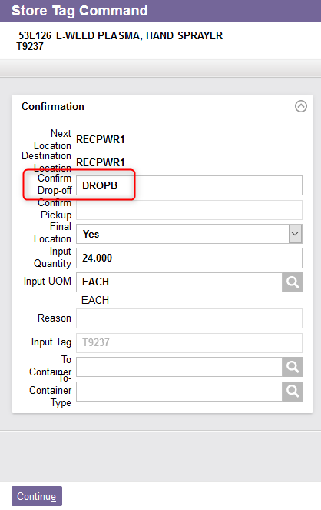
Step 6 – Release for Putaway
The Store Tag Command window is displayed. Confirm the Drop-off zone.
Click on Continue.
The release for put away for this item is now complete.

Slide 38
Basic Receiving

Slide 39
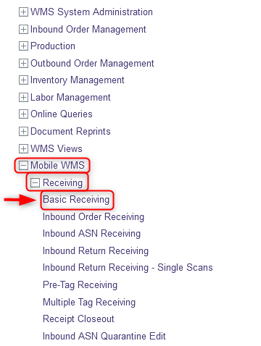
Basic Receiving
Note: To receive products without a purchase order, it is possible to perform a basic receiving in the WMS. This may be the case for marketing products whose product(s) value is $0. To do this:
With your mobile device, select the Receiving resource.
Under Receiving, Click on Basic Receiving.

Slide 40
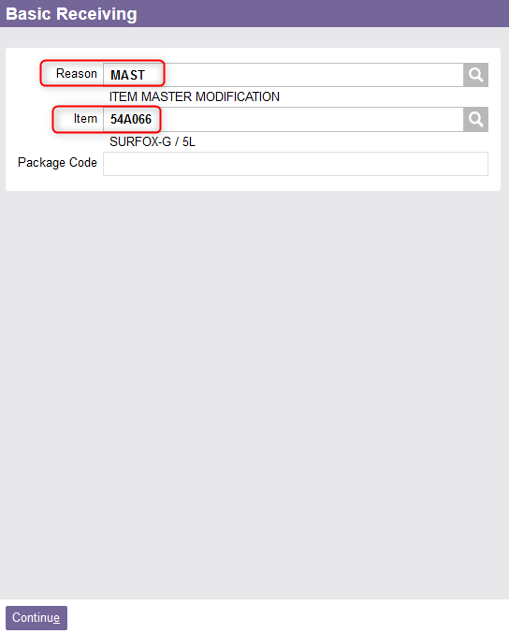
Basic Receiving
From the Basic Receiving window, enter the appropriate reason and the item to be received.
Click on Continue.

Slide 41
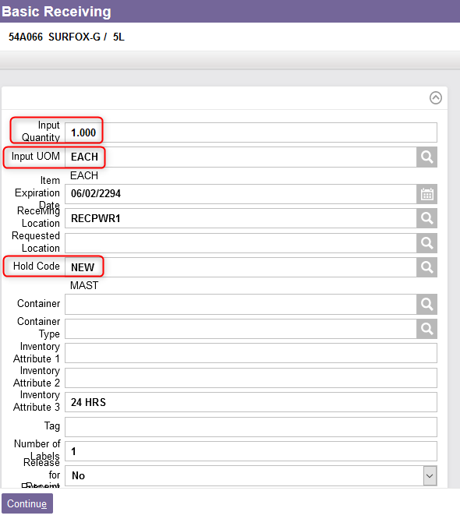
Basic Receiving
On the second page that appears, confirm the quantity and the unit of measure.
If required, enter a hold code (e.g. for a damaged item, discontinued item, new item, etc.). Use the lookup button to find the right code if necessary.
Click on Continue.
This ends the process of basic receiving for the item.

